Slide 1
Cariad DX One: Prompt Engineering Workshop
A Use Case Based Approach for Product Owners
05 March 2025, Berlin

Slide 2

What We’ll Cover
Introduction
Workshop Overview
Use Case Based Learning
Microsoft Copilot 365
Takeaways

Slide 3


Who Am I
Neil Sinclair, Senior Data Scientist, diconium Berlin
Deloitte strategy consultant turned data scientist
Projects: retail, insurance, and numerous GenAI projects

Slide 4
Overview of the Workshop
Who the Workshop Was Designed For
You work as a Product Owner / Manager
You have some, but not extensive experience with GenAI
You want to reduce tasks that take up a lot of time and have little value so you can focus where you make the biggest impact – making decisions and delivering products

Slide 5
Overview of the Workshop
Who the Workshop Was Designed For
Our Approach
You work as a Product Owner / Manager
You have some, but not extensive experience with GenAI
You want to reduce tasks that take up a lot of time and have little value so you can focus where you make the biggest impact – making decisions and delivering products
We will focus on use-cases to help you be more efficient
We will learn techniques only as they support the use-cases
This is a hands-on session – a lot of the time you’ll be working

Slide 6

Overview of the Workshop
Who the Workshop Was Designed For
Our Approach
The Expert
You work as a Product Owner / Manager
You have some, but not extensive experience with GenAI
You want to reduce tasks that take up a lot of time and have little value so you can focus where you make the biggest impact – making decisions and delivering products
We will focus on use-cases to help you be more efficient
We will learn techniques only as they support the use-cases
This is a hands-on session – a lot of the time you’ll be working

Slide 7
Overview of the Workshop
Who the Workshop Was Designed For
Our Approach
The Expert
You work as a Product Owner / Manager
You have some, but not extensive experience with GenAI
You want to reduce tasks that take up a lot of time and have little value so you can focus where you make the biggest impact – making decisions and delivering products
We will focus on use-cases to help you be more efficient
We will learn techniques only as they support the use-cases
This is a hands-on session – a lot of the time you’ll be working
The Executive Assistant

Slide 8
Overview of the Workshop
Who the Workshop Was Designed For
Our Approach
The Expert
You work as a Product Owner / Manager
You have some, but not extensive experience with GenAI
You want to reduce tasks that take up a lot of time and have little value so you can focus where you make the biggest impact – making decisions and delivering products
We will focus on use-cases to help you be more efficient
We will learn techniques only as they support the use-cases
This is a hands-on session – a lot of the time you’ll be working
The Executive Assistant
The Researcher

Slide 9
Capabilities and Drawbacks
What Language Models Excel At
Generating text
Writing documents or code
Summarising text
Research
Reasoning (Limited)
Data processing (e.g. classification)
Planning and ideation with or without data
Information retrieval*
Semantic (meaning-based) search
*This is not specific to recent LLMs, but has been popularised recently

Slide 10
Capabilities and Drawbacks
What Language Models Excel At
What We Need to Watch Out For
Generating text
Writing documents or code
Summarising text
Research
Reasoning (Limited)
Data processing (e.g. classification)
Planning and ideation with or without data
Information retrieval*
Semantic (meaning-based) search
Language models give convincing answers – even when they aren’t real
This is called hallucination
Language models are tools, not replacements for people
Limited to knowledge in its training data which may not be relevant or true any more
Responses are not always the same – even for the same input
*This is not specific to recent LLMs, but has been popularised recently

Slide 11
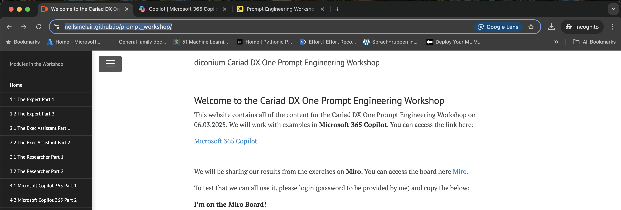
Overview of the Browser
Content and Instructions webpage
Copilot 365
Miro Board

Slide 12
The Expert
Adding an expert to your team

Slide 13

Starting with the Basics: The Expert
Let’s get started!
Go to your browser.

Slide 14
Key Takeaways
The instruction message defines the character of the bot
Add information about your company or product to get more custom results
More detail is better
The process is experimental – create, test and iterate
You can get more detail by asking your bot questions about its results
You can save your best prompts for later, enabling you to store useful bots

Slide 15
The Executive Assistant
A personal executive assistant so you can focus on what matters

Slide 16

The Executive Assistant
Like a great executive assistant, your personal bot can take over some of the boring work you need to do. It can:
translate something quickly
draft the perfect email in seconds
create a quick summary of the main points in a document and then write some content with that

Slide 17
Key Takeaways
Your assistant can speed up mundane tasks
The instruction message helps to set the tone of your assistant
Give your assistant the key points and they can fill in the rest
You can iterate on the work with the assistant by asking it to change parts of its work
You can give your assistant documents to work off
You MUST check their work before you send it off

Slide 18

10 minute break

Slide 19
The Research Assistant
Giving your assistant documents and extracting insights

Slide 20

Reasoning and Analysis
Bots are very good at generating text which looks correct, but which has no basis in truth – we must watch out for this
Like a good student with a good textbook in front of them, bots are (surprisingly) good at reasoning when the information they have is good
When a bot generates a response using an external document, we call this Retrieval Augmented Generation - RAG for short
If we give our bot data, we can get it to generate insights out of the data – i.e., reason on the data

Slide 21
Key Takeaways
Providing your assistant with information to answer a question vastly improves its accuracy
You can do this by uploading one or more documents
You can tell your assistant how you want it to answer/summarise/analyse information
You can ask your assistant for insights (i.e. not just a summary) on one or more documents
Copilot can go online and do research as well
This is an analysis aid, not a replacement for in-depth analysis

Slide 22
Microsoft Copilot 365
Connecting an Assistant with Your Documents

Slide 23

Microsoft Copilot 365
Microsoft Copilot 365 allows one to create an assistant within your company’s Microsoft ecosystem
Your assistant can have access to:
Your emails
Your files
Microsoft Office apps
All of this is within a data-safe environment

Slide 24
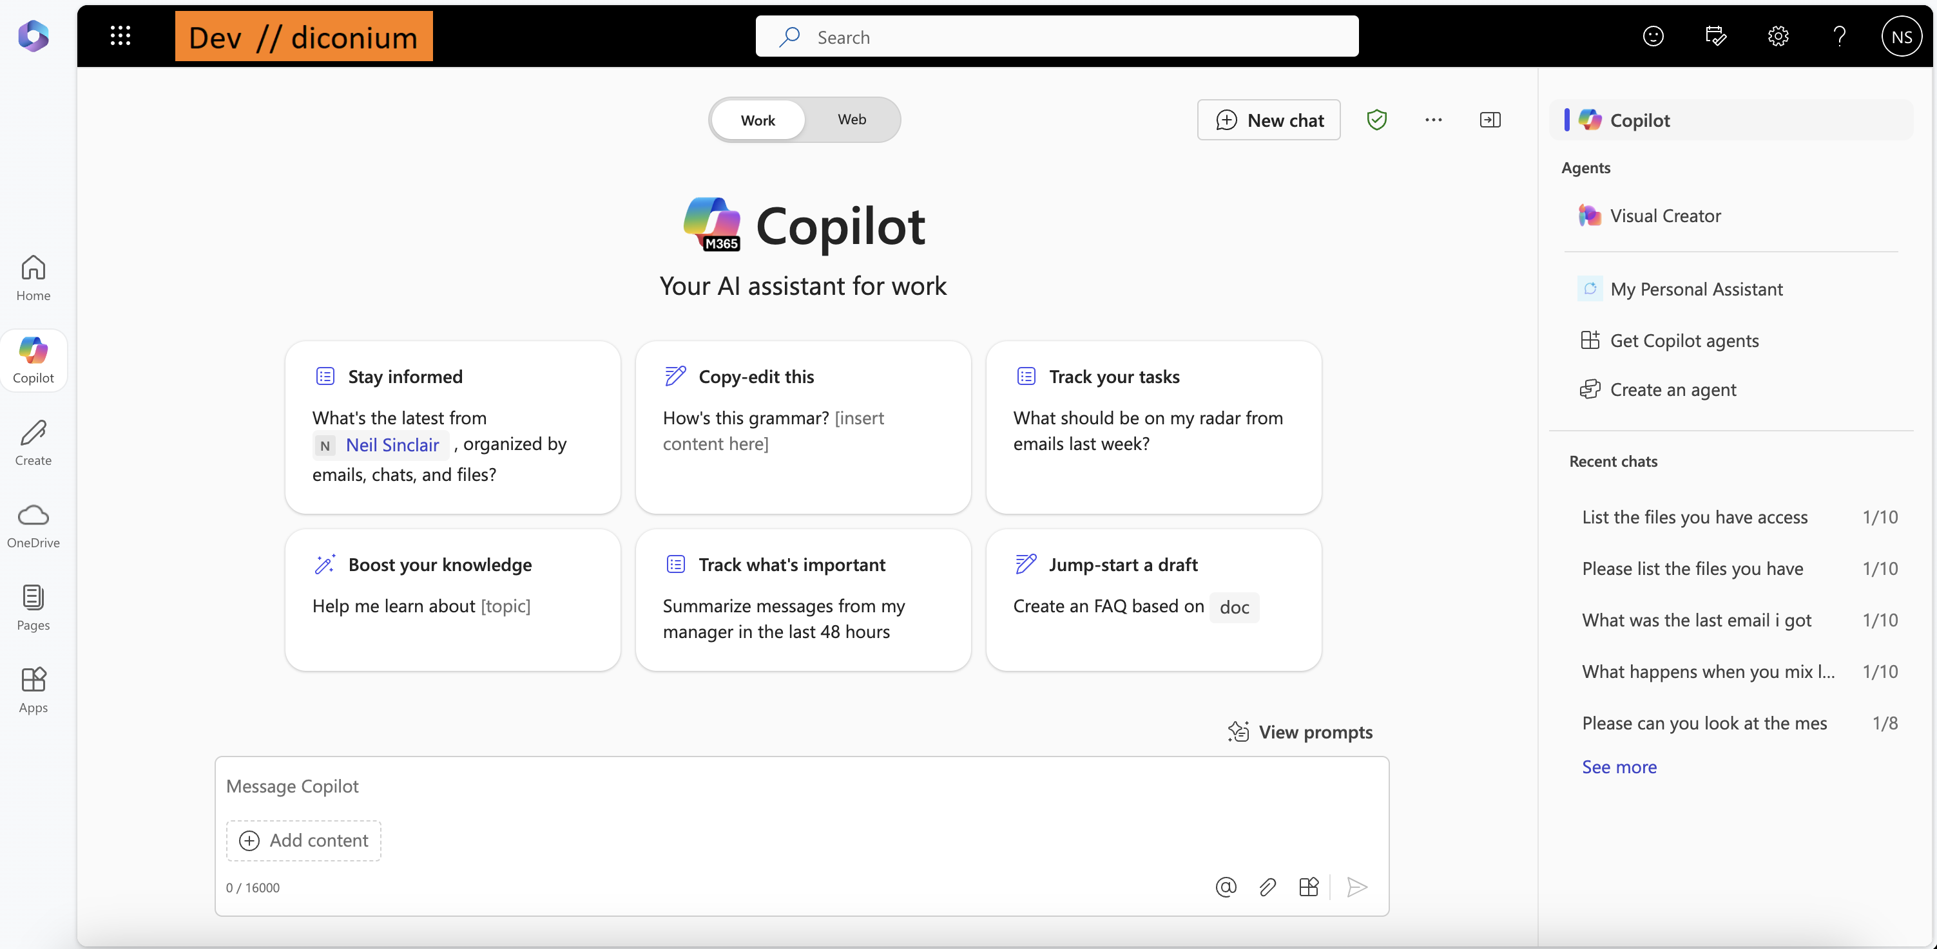
Overview of the MS365 Copilot
Toggle between ”Work” and “Web”
Start a new chat
Previous chats
Saved prompts
User message window
Attach a file
Attach a file

Slide 25
Key Takeaways
Three things to remember from today

Slide 26
Key Takeaways
With planning and iteration, we can use GenAI tools to take over tedious parts of our jobs

Slide 27
Key Takeaways
With planning and iteration, we can use GenAI tools to take over tedious parts of our jobs
GenAI is amazing, but it makes convincing mistakes. It’s vital to watch out for these

Slide 28
Key Takeaways
With planning and iteration, we can use GenAI tools to take over tedious parts of our jobs
GenAI is amazing, but it makes convincing mistakes. It’s vital to watch out for these
Experimentation and sharing is essential – this is a learn-by-doing skill

Slide 29

Let’s update your industry and build a more desirable future – together.

